Slide 1
Program Optimization
Lecturer: Ngo Huy Bien
Software Engineering Department
Faculty of Information Technology
VNUHCM - University of Science
Ho Chi Minh City, Vietnam
nhbien@fit.hcmus.edu.vn

Slide 2

Objectives
To improve system performance
To apply table driven methods to write more understandable code

Slide 3

Contents

Slide 4

References
Steve McConnell (2004). Code Complete. Microsoft Press.
Matt Perdeck (2010). ASP.NET Site Performance Secrets.

Slide 5

Performance Issue

Slide 6
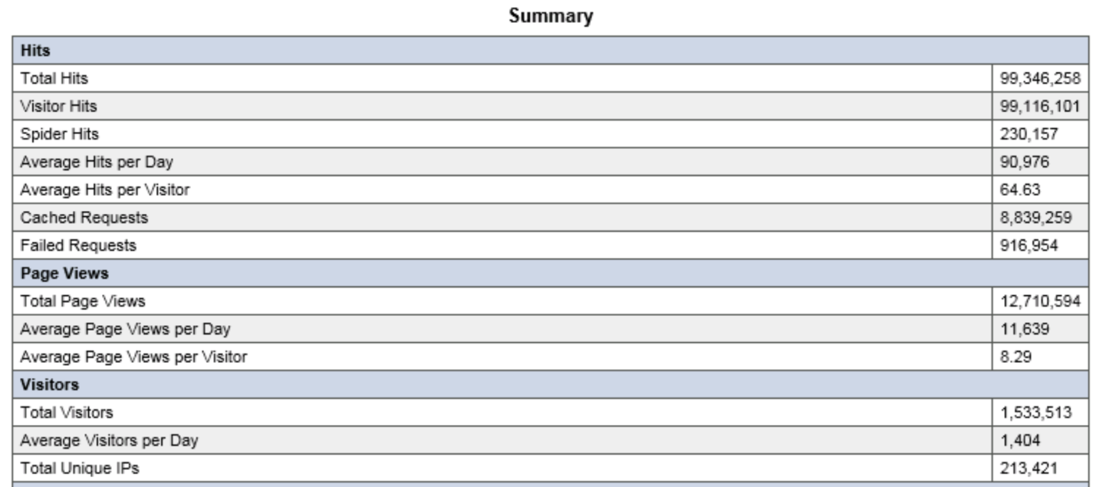
1. Monitor Web Requests
https://www.weblogexpert.com/lite.htm
https://www.nagios.com
https://www.dynatrace.com/technologies/net-monitoring/

Slide 7
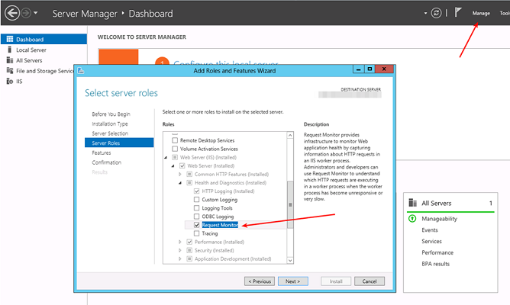
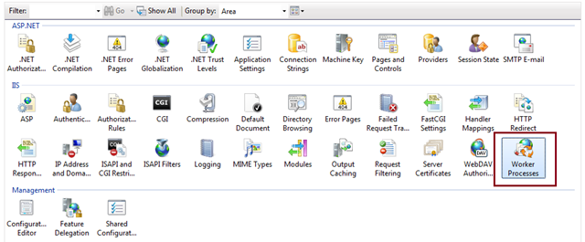
2. Use IIS Worker Process

Slide 8


Slide 9
Web Application Performance Levels
UI (JS/HTML/CSS) level
https://developers.google.com/speed/pagespeed/insights/
https://www.webpagetest.org
http://minify.mobi
https://tools.pingdom.com
https://www.whynopadlock.com
https://gtmetrix.com
Code level
Code profiling
DB level
Server level
Network level

Slide 10
1. Use UI Bundling and Minification
https://weblogs.asp.net/scottgu/new-bundling-and-minification-support-asp-net-4-5-series

Slide 11
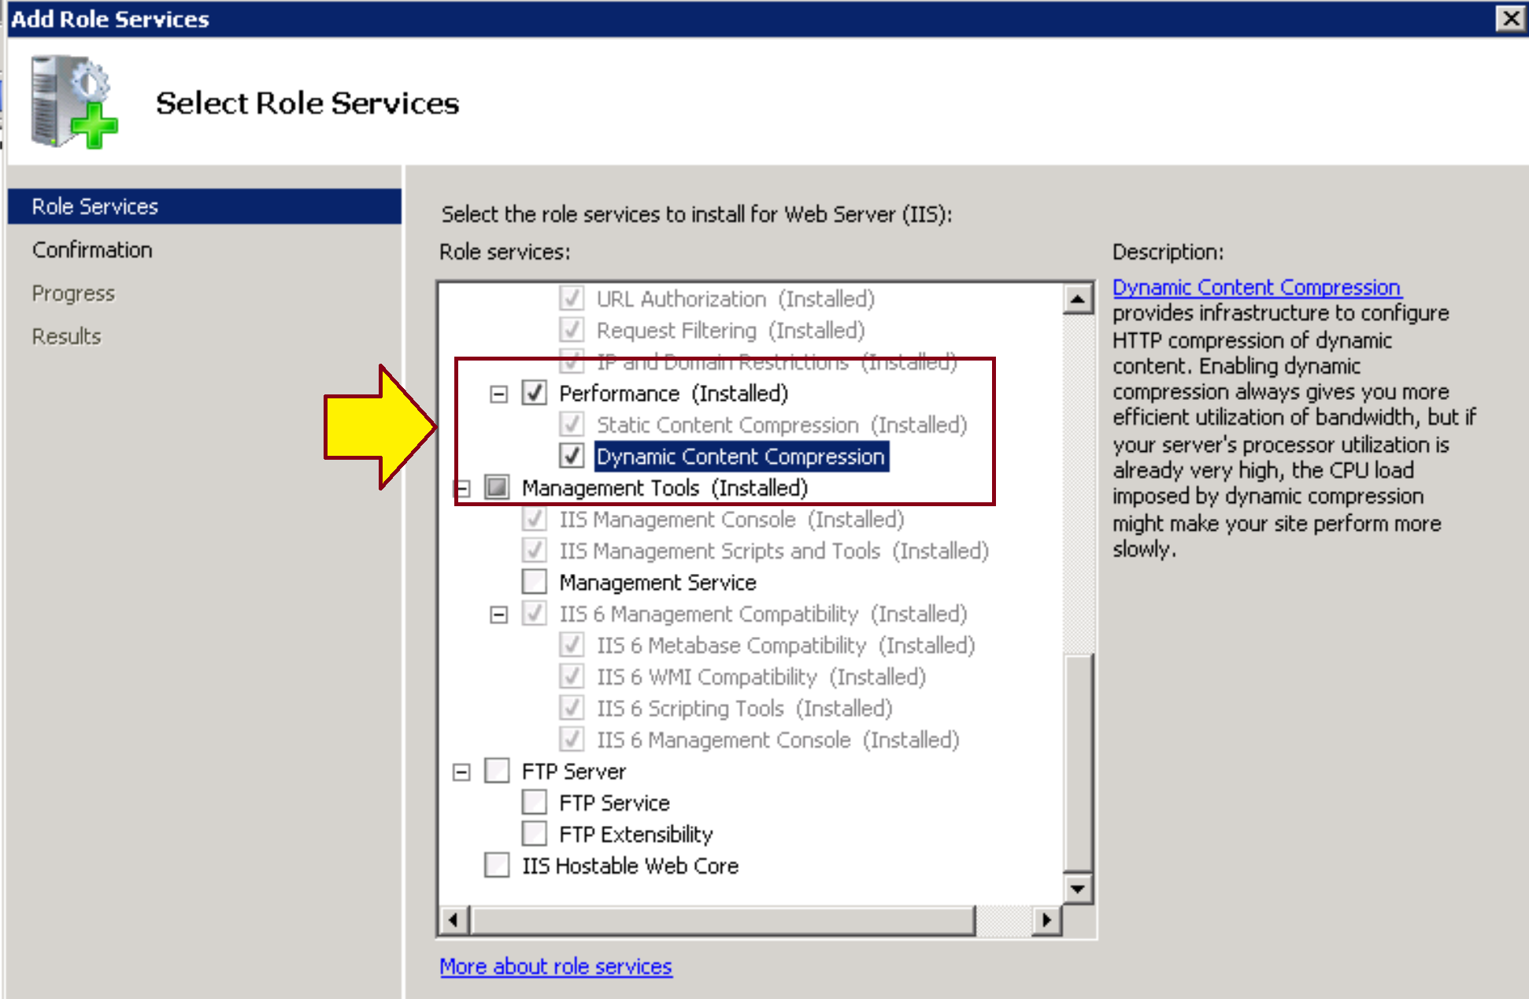
2. Use Data Transfer Compression

Slide 12
3. Leverage Browser Caching
<system.webServer>
<staticContent>
<clientCache cacheControlCustom="public" cacheControlMode="UseMaxAge" cacheControlMaxAge="31.00:00:00" />
</staticContent>
</system.webServer>

Slide 14
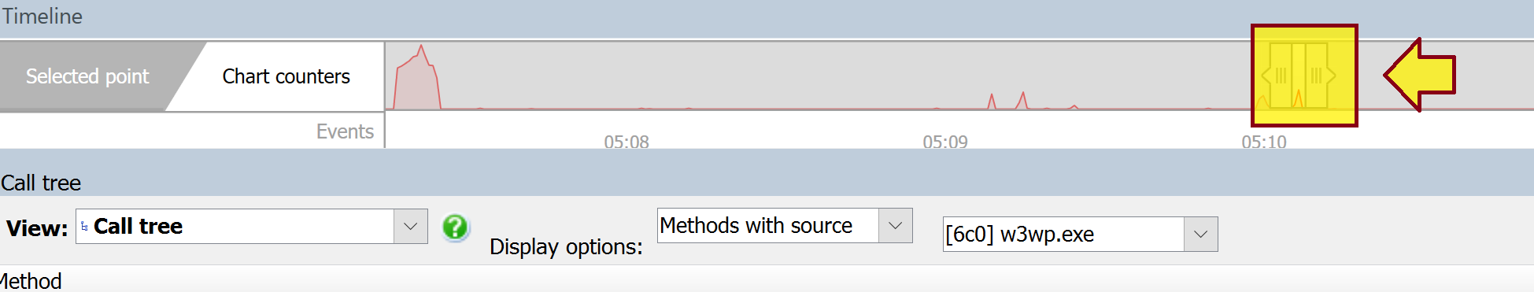
1. Detect Code Bottlenecks
http://www.red-gate.com/products/dotnet-development/ants-performance-profiler/
http://www.red-gate.com/products/dotnet-development/ants-performance-profiler/walkthrough
https://www.jetbrains.com/profiler/
https://www.jetbrains.com/help/profiler/2017.1/Get_Started_with_Performance_Viewer.html

Slide 15
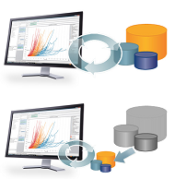
2. Avoid Inefficient Code [1]
Input/output operations. One of the most significant sources of inefficiency is unnecessary input/output (I/O).
If you have a choice of working with a file in memory vs. on disk, in a database, or across a network, use an in-memory data structure unless space is critical.
Explicitly dispose or close all the resources
Leaving debugging code turned on (such as logging trace information to a file).
Forgetting to de-allocate memory.
Polling nonexistent devices until they time out.

Slide 16

3. Select Appropriate Data Structures
Use faster libraries (e.g. StringBuilder vs. String, IList<T> vs. ArrayList)
OutOfMemoryException while populating MemoryStream
MemoryStream has internal byte[] buffer to keep all the data. It cannot predict exact size of this buffer, so it just initializes it with some initial value.
When this internal buffer can not fit all the data, it should be "re-sized", but in real life it means creating new buffer twice as size as previous one, and then copying data from old buffer to new buffer.
So, if the length of your buffer is 256Mb, and you need new data to be written, this means that .Net need to find yet another 512Mb block of data - having all the rest in place, so heap should be at least 768Mb on the moment of memory allocation when you receive OutOfMemory.

Slide 17
4. Select Appropriate Algorithms
Quick sort vs. Selection sort

Slide 18
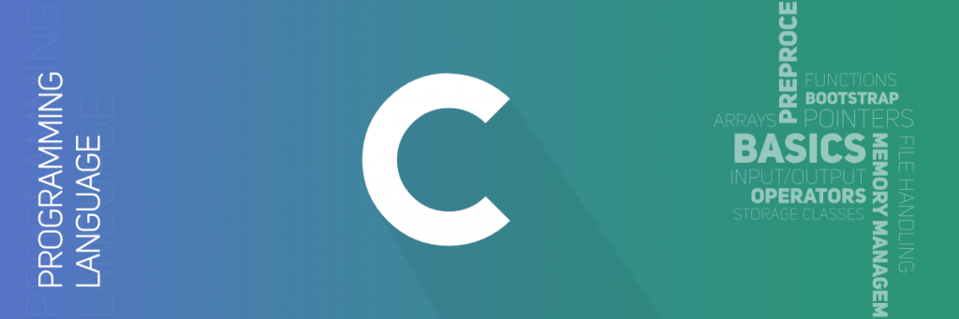
5. Use Low-Level Languages

Slide 20
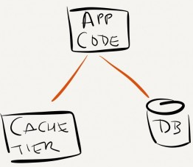
1. Cache Data
http://memcached.org/

Slide 21
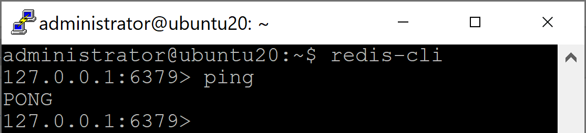
2. Install Redis on Ubuntu
Install Redis
sudo apt-get update
sudo apt-get install redis-server
Start Redis
redis-server
The service may already be started automatically.
Check if Redis is working
redis-cli

Slide 22
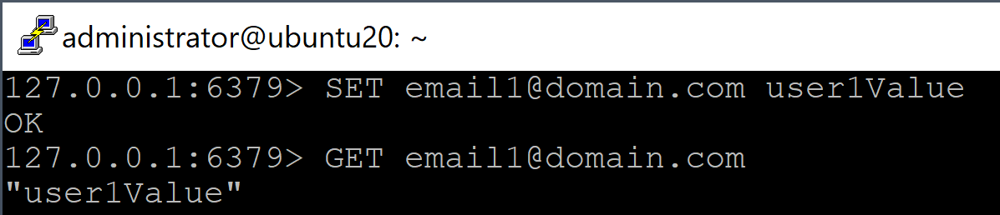
3. Call Redis APIs
SET email1@domain.com user1Value
GET email1@domain.com

Slide 23
4. Enable Remote Connections for Redis
sudo nano /etc/redis/redis.conf
bind 0.0.0.0 ::1
protected-mode no
sudo ufw allow 6379
sudo ufw allow 6379/tcp
sudo service redis-server restart

Slide 24
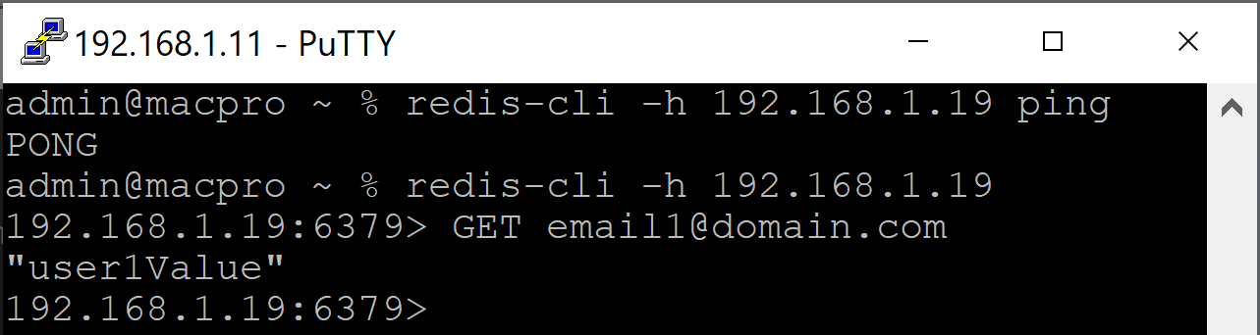
5. Connect to a Remote Redis Server
On 192.168.1.11 computer.
redis-cli -h 192.168.1.19 ping
redis-cli -h 192.168.1.19
GET email1@domain.com

Slide 25
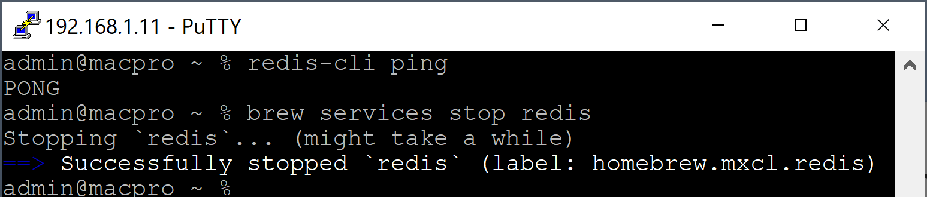
Install Redis on macOS
brew update
brew install redis
brew services start redis
redis-cli ping
brew services stop redis

Slide 26
Monitor .NET Memory Cache
Start an elevated console prompt (right-click the shortcut and use Run as Administrator) and type these commands:
cd C:\Windows\Microsoft.NET\Framework\v4.0.30319
lodctr netmemorycache.ini
That adds the required registry entries so the MemoryCache can create these counters at runtime.
Start your program so an instance of MemoryCache is created.
Run Perfmon.exe, right-click the graph, Add Counters and pick from the added .NET Memory Cache 4.0 category.
Also select the instance of your program.

Slide 28
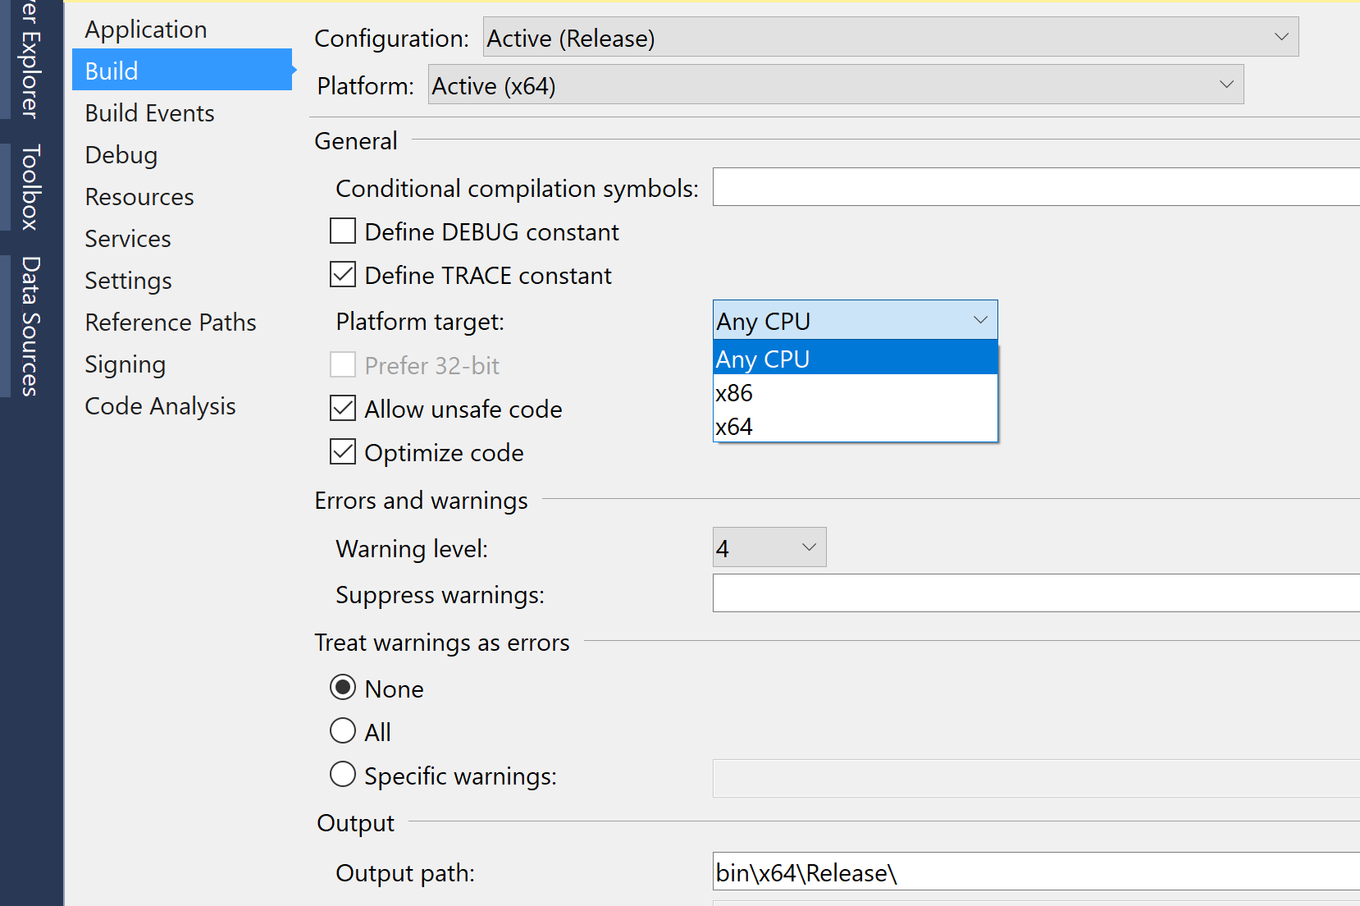
1. Use 64bit Process

Slide 29


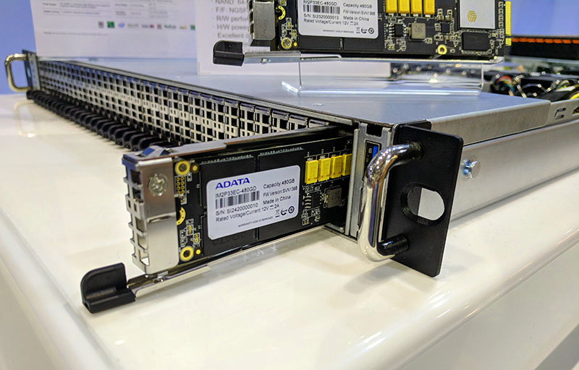
2. Increase Hardware Capability

Slide 31

Optimize Data Access Speed
Properly designing database.
Getting only needed data
Implementing database paging
Using indexes
CREATE INDEX UserIdIndex ON Users (UserId)

Slide 32
Avoid Expensive Queries [2]
Using full-text search instead of LIKE
SELECT Title, Author FROM dbo.Book WHERE Title LIKE '%Quixote'
Avoiding functions on columns in WHERE clauses
SELECT Title, Author FROM dbo.Book WHERE LEFT(Title, 1)='D‘
SELECT Title, Author FROM dbo.Book WHERE Title LIKE 'D%'
Using EXISTS instead of COUNT to find existence of records
DECLARE @n int
SELECT @n = COUNT(*) FROM dbo.Book
IF @n > 0
print 'Records found‘
IF EXISTS(SELECT * FROM dbo.Book)
print 'Records found'

Slide 33
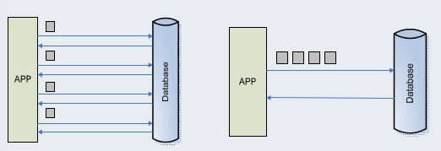
Reduce Database Round Trips

Slide 34
Manage Connection Pooling
See “Database Management Systems” >> “04. SQL Server Deadlocks.pptx”

Slide 35
SQL Statements vs. Stored Procedures
http://www.sommarskog.se/dynamic_sql.html
Stored procedure advantages
Reducing network traffic
Encapsulating logic (modularizing your code)
Keeping track of what is used (you can use sp_depends if you use SPs)
Addressing bugs and problems

Slide 37
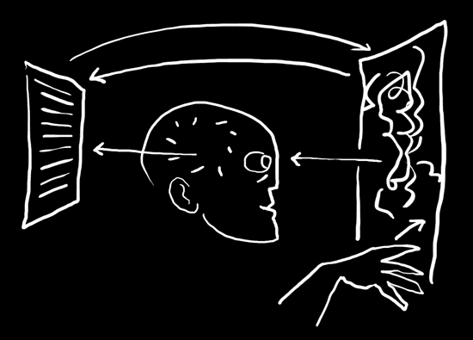
Complicated Logic [1]

Slide 38
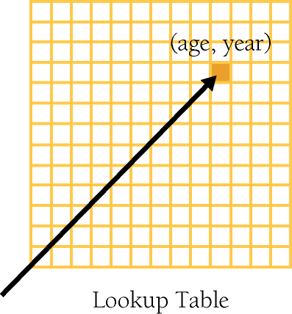
Direct Access Tables
A table-driven method is a scheme that allows you to look up information in a table rather than using logic statements (if and case) to figure it out.
Classify a Character

Slide 39
Classifying a Character
Put your program's knowledge into its data rather than into its logic—in the table instead of in the if tests.
private static IDictionary<char, string> CharacterTypes
{
get
{
IDictionary<char, string> characterTypes = new Dictionary<char, string>();
characterTypes.Add('a', "Letter");
characterTypes.Add('b', "Letter");
characterTypes.Add('c', "Letter");
//...
characterTypes.Add('8', "Digit");
characterTypes.Add('9', "Digit");
return characterTypes;
}
}
static void Main(string[] args)
{
char inputChar = Console.ReadKey().KeyChar;
Console.WriteLine(CharacterTypes[inputChar]);
}

Slide 40
Day-In-Month
leap year?

Slide 41
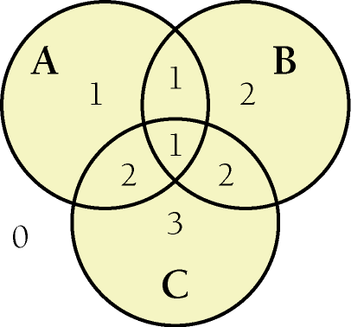
Assigning the Category Numbers
if ( ( a && !c ) || ( a && b && c ) ) {
category = 1;
}
else if ( ( b && !a ) || ( a && c && !b ) ) {
category = 2;
}
else if ( c && !a && !b ) {
category = 3;
}
else {
category = 0;
}

Slide 42
Insurance Rate

Slide 43
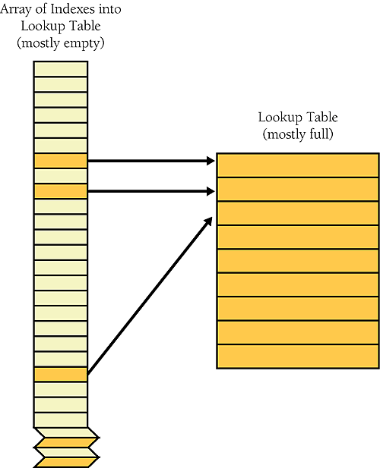
Indexed Access Tables
Rather than being accessed directly, an indexed access table is accessed via an intermediate index.
0000
Age | Key
0 | 1
1 | 1
2 | 1
3 | 1
18 | 2
19 | 2
Key | G | M | S | R
1 | M | Y | N | 20
1 | M | Y | Y | 25
1 | M | N | N | 27
1 | M | N | Y | 30
2 | M | Y | N | 37
2 | M | Y | Y | 40
1
20
When you use indexes, you use the primary data to look up a key in an index table and then you use the value from the index table to look up the main data you're interested in.
125

Slide 44
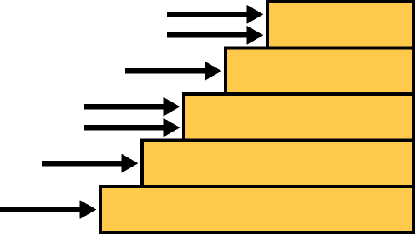
Stair-Step Access Tables
The stair-step approach categorizes each entry by determining the level at which it hits a "staircase." The "step" it hits determines its category.
Range | Grade
>= 9 | A
< 9 | B
< 8.5 | C
< 8 | D
< 7.5 | E
< 6 | F
< 5 | G
9
8.5
8
7.5
To use the stair-step method, you put the upper end of each range into a table and then write a loop to check a score against the upper end of each range. When you find the point at which the score first exceeds the top of a range, you know what the grade is.

Slide 45
Stair-Step Table Lookup
double studentScore = 6.8;
string studentGrade = string.Empty;
double[] scoreRange = new double[] { 5, 6, 7.5, 8, 8.5, 9 };
string[] grades =
new string[] { "G", "F", "E", "D", "C", "B", "A" };
for (int count = 0; count < scoreRange.Length; count++)
{
if (studentScore < scoreRange[count])
{
studentGrade = grades[count];
break;
}
}

Slide 46

Thank You & See You Again

